Slide 1

TESTING THE SECURITY OF AN AI-BUILT APPLICATION: SECURE FILE ENCRYPTION/DECRYPTION TOOL IN A CLIENT-SERVER SETTING

Slide 2
The Goal:
To ascertain the security of an application built with Chatgpt 4o mini.
The Application:
A secure client-server application for encrypting and decrypting files using Python

Slide 3
Technology Stack
Programming Language: Python
Backend Framework: Flask API
Encryption/Decryption: AES-GCM
Communication: HTTPS/TLS
Client: Python GUI (Tkinter)
Authentication: API keys

Slide 4
How it works
Client:
Uploads files for encryption/decryption.
Sends encryption keys or passwords securely.
Downloads encrypted or decrypted files.
Server:
Receives and processes file requests.
Encrypts and authenticates the files.
Derives encryption keys from passwords securely.
Returns encrypted or decrypted files to the client.

Slide 5
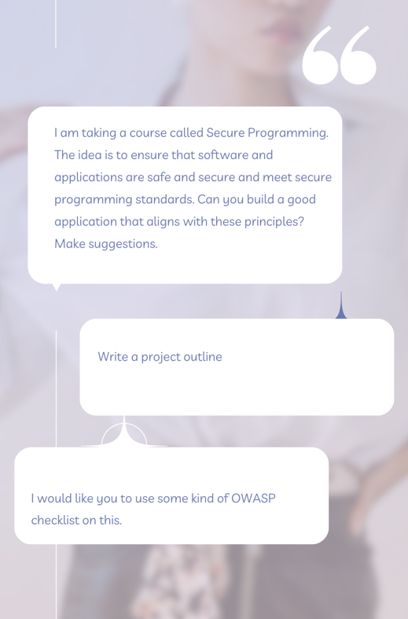
Security Implementations & Prompts
OWASP Top 10 Checklist
AES-GCM for authenticated encryption.
PBKDF2 for key derivation.
API key client authentication.
Rate limiting to prevent brute force attacks.

Slide 6
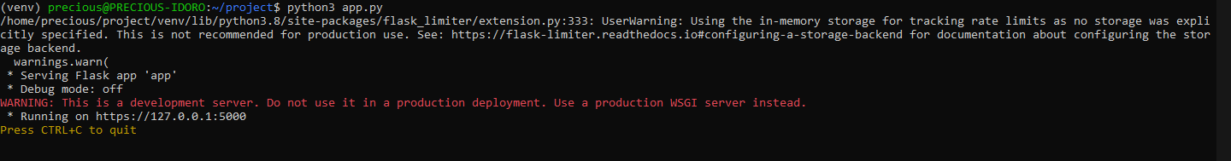
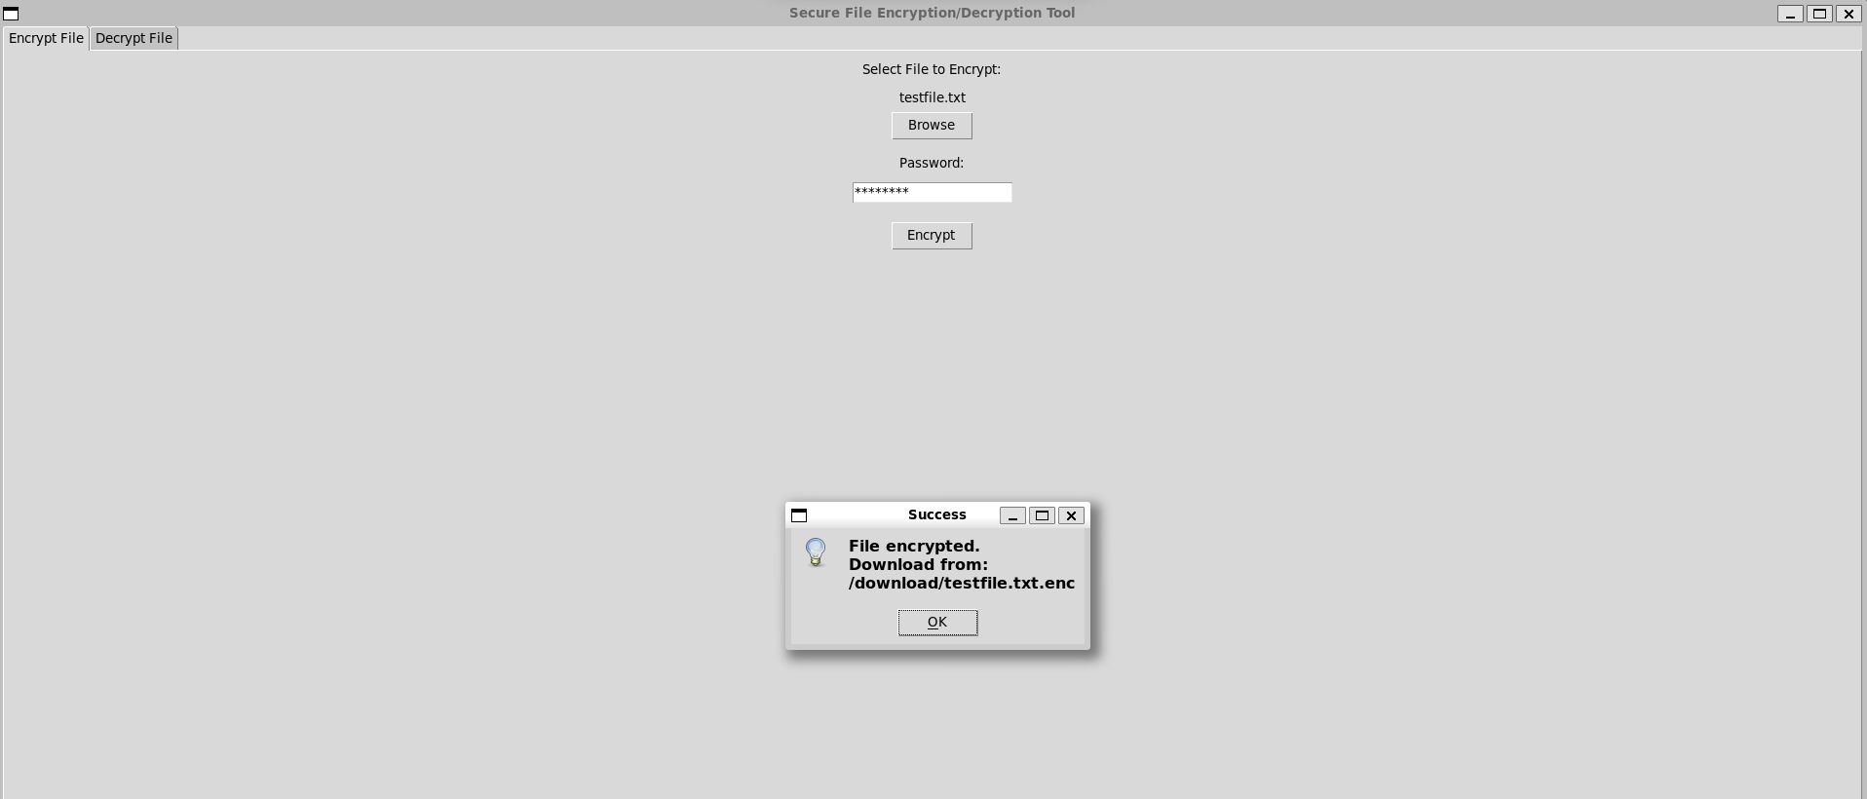
Server starts up
Client encrypts and decrypts files based on a password

Slide 7
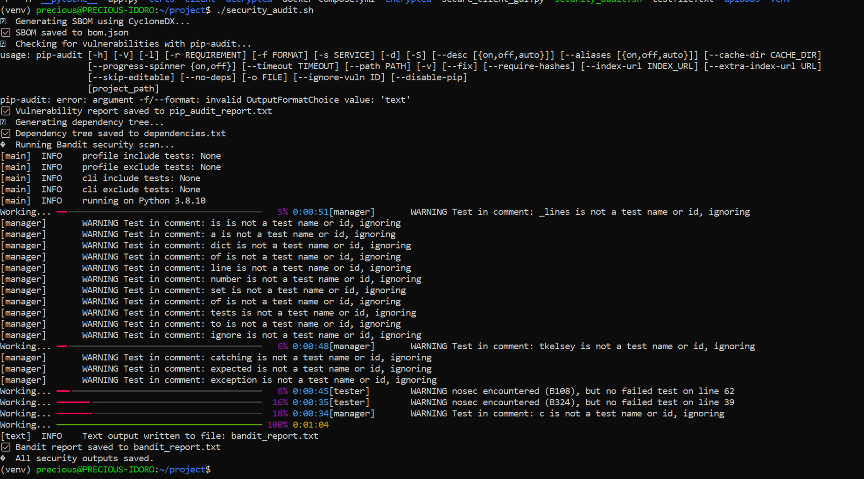
Tests & Results
Cyclondx-py & OWASP Dependency Track
Pip-Audit
Bandit

Slide 8
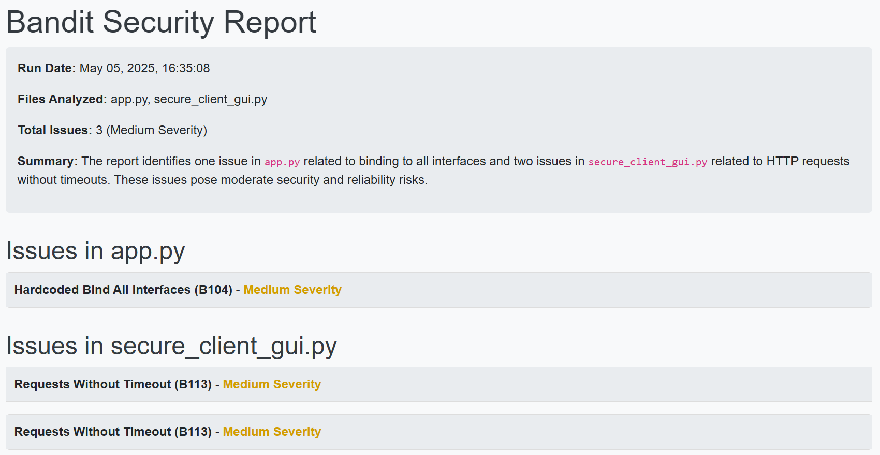
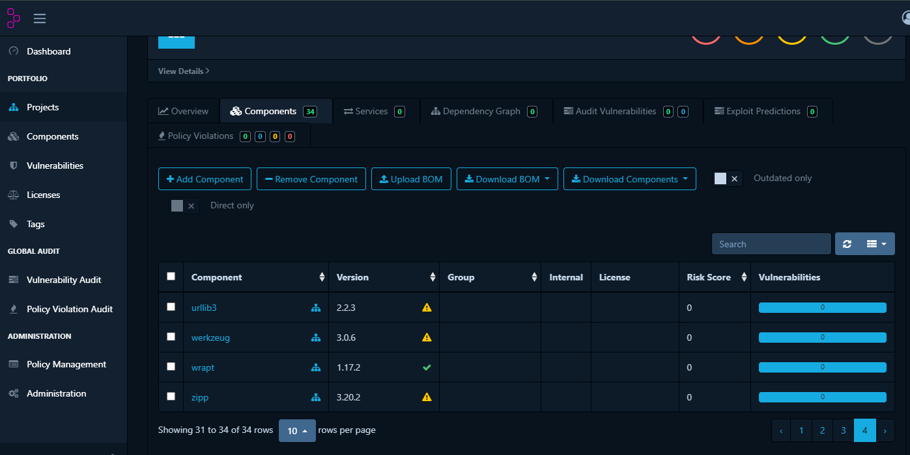
Tests & Results

Slide 9
Conclusion
Chatgpt 4o mini can be trusted, to an extent, to follow secure programming principles only if guided properly. Even then, some vulnerabilities may slip through the cracks.
This work can be made more robust with more time. The scope can be expanded to test the free/paid versions of various Generative AI applications, using predefined and unified prompts across the board.
Notes:
Reputation system
Since there are no rule of law, the seller level, ratings and how long the vendor has operated on the marketplace play a role in how trusted the buyers view the vendor
Further research
Use of crawlers or scrapers on the page would increase the data samples and the accuracy of the study
Also the longer researchers collect data on the marketplaces the more they can say about how many sales a vendor makes and get a better understanding of the fluctuating prices

Slide 10
AI Use
Grok 3 was used to filter and convert the bandit report from .txt to .html for visualization.
Notes:
Reputation system
Since there are no rule of law, the seller level, ratings and how long the vendor has operated on the marketplace play a role in how trusted the buyers view the vendor
Further research
Use of crawlers or scrapers on the page would increase the data samples and the accuracy of the study
Also the longer researchers collect data on the marketplaces the more they can say about how many sales a vendor makes and get a better understanding of the fluctuating prices

